Slide 1
Robust Driver Assistance System based on Computer Vision
Anishsanjay Nayak
G40823950

Slide 2
Driver Assistance Systems
Developed to automate/adapt/enhance vehicle systems for safety and better driving
Features designed to avoid collisions and accidents by offering alerts to potential problems or taking over control of the vehicle
Relies on inputs from various sources like:
Automotive sensors
LiDAR
Radar
Image processing
Computer Vision

Slide 3
Driver Assistance Systems (features)
Adaptive/Autonomous cruise control
Automotive navigation system
Collision avoidance system
Driver monitoring system
Lane departure warning
Traffic sign recognition
Notes:
Cruise control – automatically adjusts vehicle speed to maintain a safe distance from other vehicles
Navigation – find the fastest route to the destination based on GPS and traffic data
Collision avoidance – reduce severity of collision by using radar, lidar and image recognition to detect an imminent crash
Driver monitoring – infrared sensors to monitor driver attentiveness
Lane departure – warning when the vehicle begins to move out of its lane

Slide 4
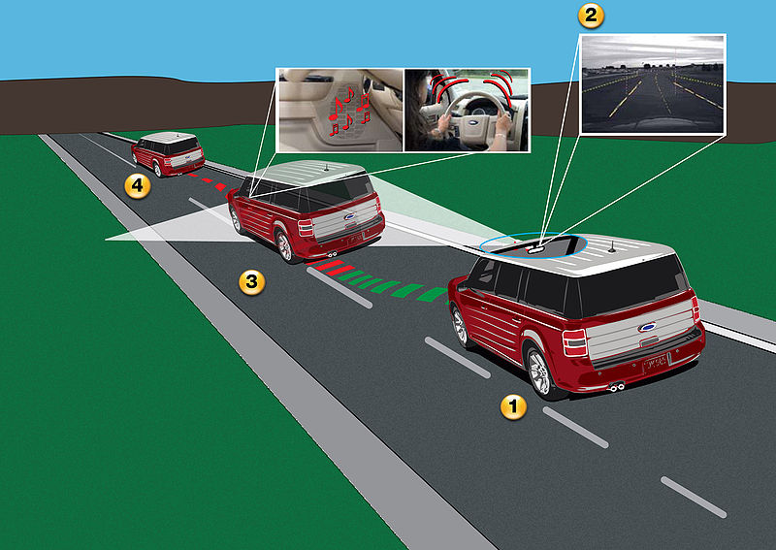
Lane departure warning systems
Warns the driver in some form (visual, audible, vibratory) if the vehicle is leaving its lane
If no action is taken, takes steps to stay within the lane
Working principle – lane detection and tracking systems to identify the current lane of travel

Slide 5
Lane detection algorithm
Capture input of the road
Camera calibration + geometric transform + noise removal
Region of interest extraction
Edge detection algorithm + line/curve fitting
Determine lane boundaries
Notes:
This process varies for different models and even locations
Robust system should be able to handle challenging scenarios like shadows from trees, or other vehicles
Also, there could be solid/broken lanes and most importantly curved roads
For example, in California there are non-reflective raised platforms called Botts’ dots
Best systems are a hybrid of various algorithms which work in every situation

Slide 6
Lane detection algorithms
Various algorithms have been developed over the past 15 years various papers and conferences of Computer Vision and Intelligent Systems
Fixed-width line pairs by H. Hattori [5]
Geometric constraint model by S.S. Leng et. Al. [6]
Steerable filters by J.C.McCall et. Al. [7]
Hough transform based by A. Suzuki [8]
Hyperbola fitting by A.AM. Assidiq et. Al. [9]
Probabilistic fitting by J. B. Southall et. Al. [10]
Frequency domain feature detection by C. Kreucher et. Al. [11]
Notes:
A road model used during region of interest extraction phase which was assumed to be of fixed-width (not true everywhere)
Constraint assumption that the lane-markings width falls into a certain known range and descriptors are designed accordingly (not robust enough)
Steerable filters are convoluted with image to detect lanes but heading of vehicle is usually required as input
Curve fitting done based on different equations after proper geometric transform

Slide 7
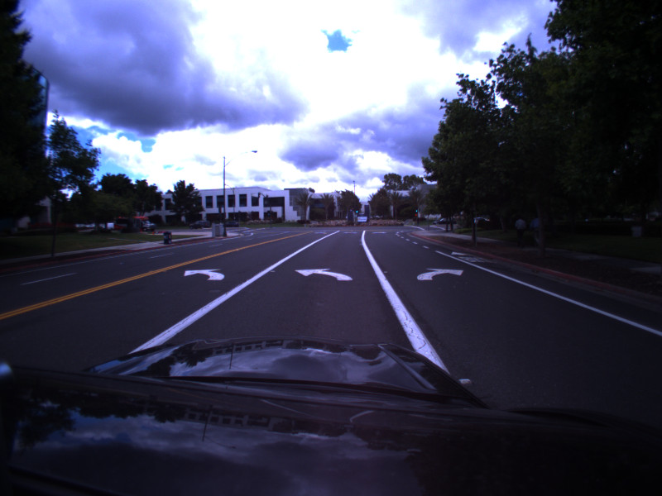
Data & Methodology
High level representation of four algorithms was implemented using a combination of MATLAB and OpenCV libraries
Dashboard-camera (dashcam) footage was used from the training dataset by T. Wu et. al. [12]
Comparison criteria – detection rate and false-alarm rate
Notes:
T. Wu was working on traffic sign detection using neural networks
Detection rate – percentage number of frames with more than 75% of the current lane detected accurately on both sides
False-alarm rate – percentage number of frames with more than 50% of the detected lane outside of the actual lane

Slide 8
Geometric model constraints
Weighted thresholding done separately for left and right lanes
Geometric model developed in the form of triangular shaped scanning lines to detect lanes
Detection rate: 174/200 = 87%
False-alarm rate: 63/200 = 31.5%
Computation time: ~45 seconds for 200 frames

Slide 9
Hough Transform
Detected lane points are passed through modified Hough transform
Rho and Theta are iterated over multiples of 3
Detection rate: 127/200 = 63.5%
False-alarm rate: 51/200 = 25.5%
Computation time: ~47 seconds for 200 frames

Slide 10
Hough Transform with horizontal slots
Region of interest split into horizontal slots and Hough transform used in each to get smoother curve
High computational optimization was required
Detection rate: 169/200 = 84.5%
False-alarm rate: 42/200 = 21%
Computation time: ~49 seconds for 200 frames

Slide 11
Curve fitting
The detected points are double-checked with the Canny edge detected points as well
The verified points are curve fitted into an equation and interpolated
Detection rate: 181/200 = 90.5%
False-alarm rate: 23/200 = 10.5%
Computation time: ~57 seconds for 200 frames
Notes:
Converted to grayscale to decrease computational requirements

Slide 12
Conclusions
Simple geometric constraints are easily distracted by shadows or other vehicles and in the case of broken lane markings causing high false-alarm rates
Hough transform is better in terms of distractions but noise can easily change the orientation of the detected lane causing poor detection rates
Curve fitted lanes are the most robust in terms of noise or distractions and also detect curved roads much better than Hough transform with horizontal slots
But they are computationally heavy compared to the other algorithms

Slide 13
References
https://en.wikipedia.org/wiki/Advanced_driver-assistance_systems
https://commons.wikimedia.org/wiki/File:Lane_Departure_Warning.jpg
https://en.wikipedia.org/wiki/Lane_departure_warning_system
https://en.wikipedia.org/wiki/Lane_departure_warning_system#/media/File:Lane_Detection_Algorithm.jpg
H. Hattori, "Stereo for 2D visual navigation", Proc. IEEE Intell. Veh. Symp., pp. 31-38, 2000
S.S. Leng, J.-P. Tarel, R. Labayrade, "On the design of a single lane-markings detector regardless the onboard camera's position", Proc. IEEE Intell. Veh. Symp., pp. 564-569, 2003
J.C. McCall, M.M. Trivedi, “An integrated, robust approach to lane marking detection and lane tracking”, IEEE Intelligent Vehicles Symposium, June 2004
A. Suzuki, N. Yasui, N. Nakano, M. Kaneko, “Lane recognition system for guiding of autonomous vehicle”, Proc. Intelligent Vehicles '92 Symposium, June 1992

Slide 14
References
A.AM. Assidiq, O. Khalifa, Md. R. Islam, S. Khan, “Real time lane detection for autonomous vehicles”, ICCCE International Conference on Computer and Communication Engineering, May 2008
J. B. Southall, C.J. Taylor, "Stochastic road shape estimation", International Conference on Computer Vision, pp. 205-212, June 2001
C. Kreucher, S. Lakshmanan, "LANA: a lane Extraction algorithm that uses frequency domain features", IEEE Transactions on Robotics and automation, 1999, pp 343-350
T. Wu, A. Ranganathan, "A Practical System for Road Marking Detection and Recognition", IEEE Intelligent Vehicles Symposium, 2012

